Slide 1

Advanced Curriculum Integration:
Assuring Rigor through the Process
Kathleen Harris, Penni Hudis, Rob Atterbury
ConnectEd: The California Center for College and Career
Aazam Irilian
National Academy Foundation
Notes:
NEEDED:
Flip chart paper and pens? Tape, Copies of HS standards in core and CTE???
Handout packet plus extra worksheets

Slide 2
Outcomes
Discuss and describe the process and the power of using student outcomes to drive C&I
Identify cross curricular connections within performance maps
Determine how the use of outcomes and performance mapping drives the rigor through relevance
Plan to introduce this process to my academy or pathway team

Slide 3
Integrated Curriculum Design
Student Outcomes
Curriculum/Performance Mapping
Share Curriculum and Find Connections
Topic Selection
Essential Question
Establish Performance Tasks/Assessments
Lesson Plans
Reflection and Revision
Industry and post-secondary partners advise in:
Curriculum Development
Instruction and Implementation
Student Assessment

Slide 4
Motivation and Rigor
Increase engagement by tapping motivation
FORCED TO….NEED TO….WANT TO
You push…..They comply…..They seek
To prepare all students for college and career
Notes:
Remember that interest and engagement are the goals, but not the only purpose for offering academies/pathways
Reinforce message about college and career. Rigor matters.

Slide 5
All things are created twice: first mentally and then physically.
The key to creativity is to begin with the end in mind, with a vision and a blueprint of the desired result.
Stephen Covey
Begin with the End in Mind
Notes:
Good advise but what is the end? What drives curriculum or lesson development in your classroom? In your academy teams?

Slide 6
Definition of Student Learning Outcomes
Level of
Assessment
College Career
Life
Example of
Alignment
District
Graduate Profile
Effective Communicator
School Site Goals/Outcomes
Communicates effectively, orally,
in writing, and non-verbally
Correctly employs specific terminology appropriate to health care settings both verbally and in writing
Pathway Outcomes
Utilizes correct medical terminology in course projects and presentations
Course Outcomes
Employs the proper terms when identifying the virological properties targeted by the vaccine solution in the pandemic project presentation.
Project Outcomes
STUDENT
Notes:
One by on fly=in

Slide 7
The Pacing Guide Dilemma
How can you design authentic lessons or projects that address your academy outcomes, are authentic to the industry theme and align to the scope, sequence and rigor of all the courses involved?

Slide 8
For Designing Curriculum...
You also begin with the end in mind
Standards-based performances assessed across the curriculum
Address an essential question
Reflects the theme of the industry sector
Built on integrated performance mapping

Slide 9
Integration Continuum
Sector theme
Math
CTE
ARTS
For
Lang
SOC
SCI
Single
Subject
Paired
Interrelated
Conceptual
BASIC INTERMEDIATE COMPLEX
9
Notes:
Diagram on p. 11

Slide 10
Integrated Lesson or Project
Standards Based -timely and identifies level of mastery
Inquiry Driven - becomes the students’ problem
Authentic -product, performance, service or solution
Personalized to motivation and skills (differentiated)
Notes:
Pairs share with one of the two sample. Be sure they read over the second one before reporting out.

Slide 11
Quality Integrated Curriculum
ACTIVITY:
Review the sample as directed using the rubric provided

Slide 12

Reflection
Session Worksheet
Question One

Slide 13

DMD Video

Slide 14
Performance Maps Can
Provide a tool for looking at your own class and how you might address relevancy and motivation
Provide a tool for looking across a student’s program to find natural connections for designing projects

Slide 15
Performance Maps Can
Be done by individual teachers or through subject area departments
Help you identify areas where a student may need skills remediation or special help.

Slide 16
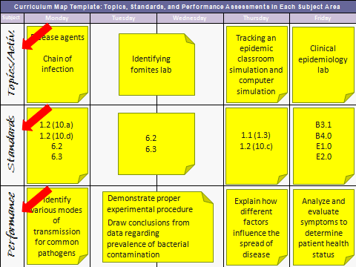
SAMPLE MAP

Slide 17
Unpacking the Standards
Verbs matter!
The verb establishes the level of learning and suggests the assessment method
The verb determines the type of activity to embed in the project

Slide 18
Defining And Assuring Rigor
Assimilation
of
Knowledge
Evaluating
Application
Comprehension
Knowledge
Synthesis
Analysis
Bloom’s Taxonomy
Thinking Continuum
Acquisition
of
Knowledge

Slide 19
Integrated Curriculum Design
Student Outcomes
Curriculum/Performance Mapping
Share Curriculum and Find Connections
Topic Selection
Essential Question
Establish Performance Tasks/Assessments
Lesson Plans
Reflection and Revision
Industry and post-secondary partners advise in:
Curriculum Development
Instruction and Implementation
Student Assessment

Slide 20
Curriculum Map Template: Topics, Standards, and Performance Assessments in a Single Subject
 | Week 1 | Week 2 | Week 3 | Week 4 | Week 5
TOPIC
STANDARDS
PERFORMANCES

Slide 21
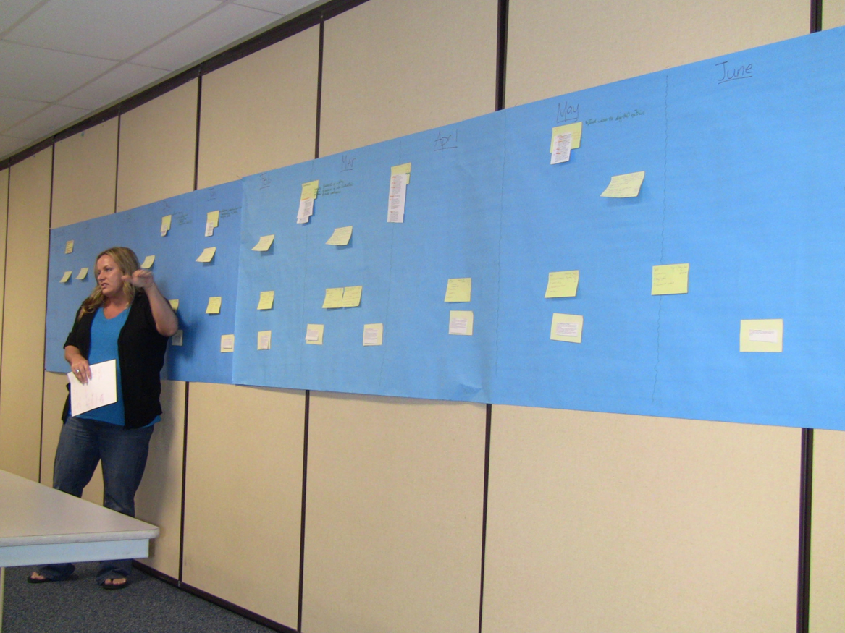
Place your post-it notes in chronological order on the butcher paper

Slide 22
Integrated Curriculum Design
Student Outcomes
Curriculum/Performance Mapping
Share Curriculum and Find Connections
Topic Selection
Essential Question
Establish Performance Tasks/Assessments
Lesson Plans
Reflection and Revision
Industry and post-secondary partners advise in:
Curriculum Development
Instruction and Implementation
Student Assessment

Slide 23
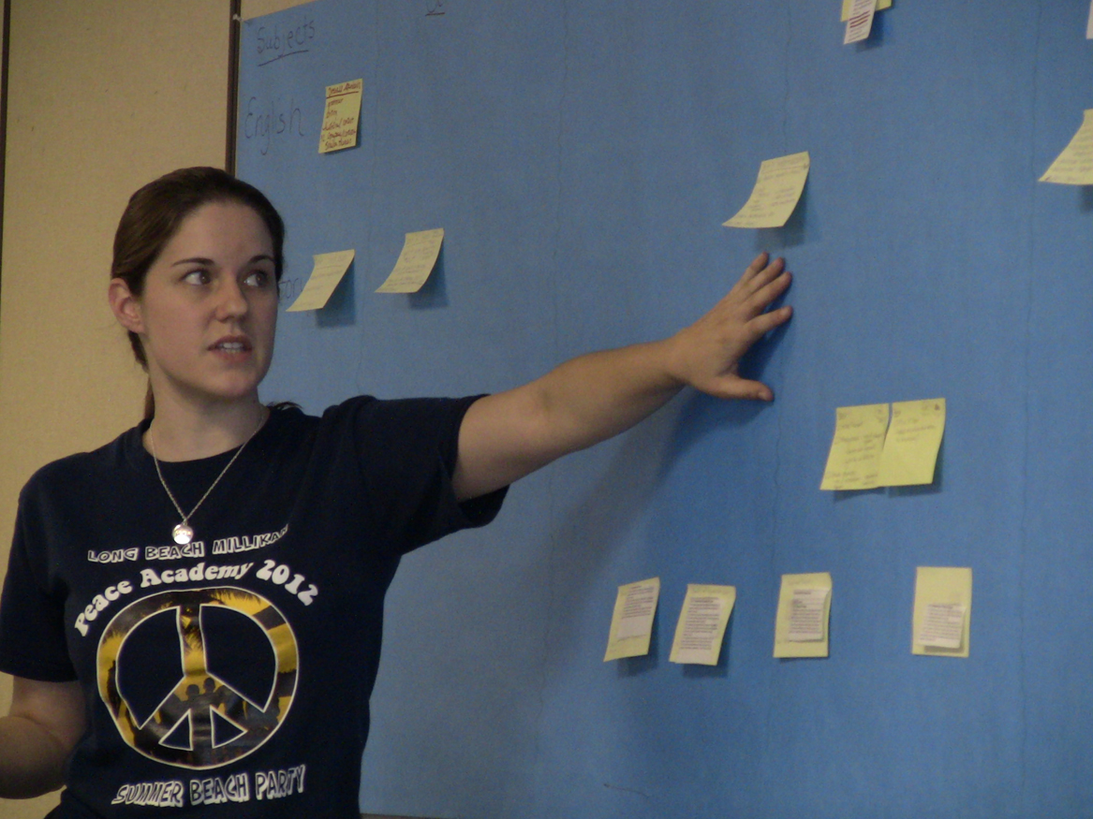
Take turns explaining the details of your content to the team.

Slide 24
Curriculum Map Template: Topics, Standards, and Performance Assessments in Each Subject Area
Subject | Week: | Week | Week | Week | Week
Algebra 1
Language Arts
H. C. Foundations

Slide 25
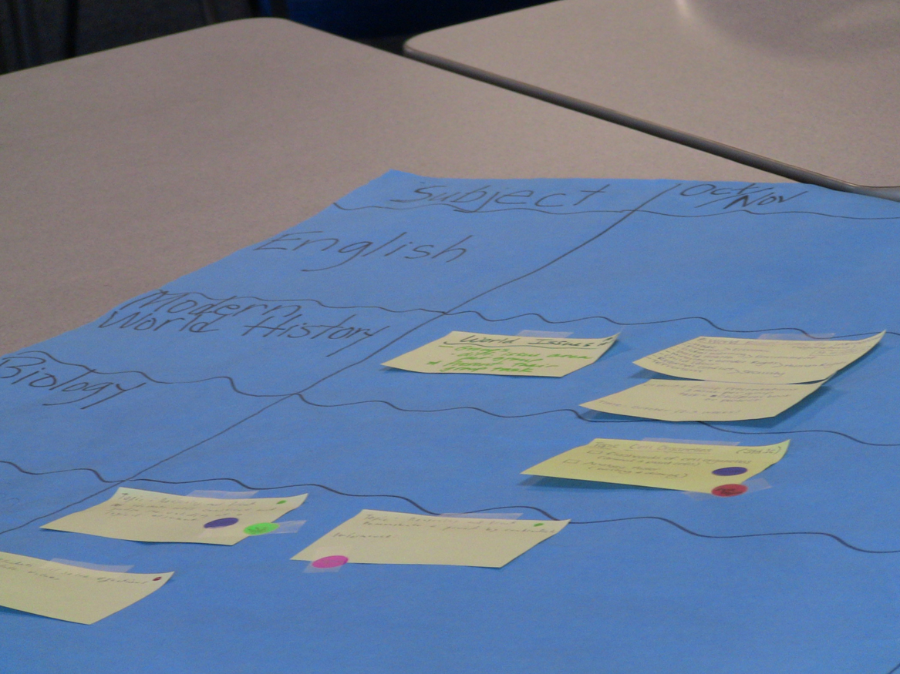
Make Connections
Notes:
Find the link—concept, idea, and/or skill in common

Slide 26
Curriculum Map Template: Topics, Standards, and Performance Assessments in Each Subject Area
Subject | Monday | Tuesday | Wednesday | Thursday | Friday
Health Science
English
Science
Demonstrate proper experimental procedure
Draw conclusions from data regarding prevalence of bacterial contamination
Identify various modes of transmission for common pathogens
Explain how different factors influence the spread of disease
Analyze and evaluate symptoms to determine patient health status
Paraphrase the research into your own words.
Formulate a preliminary thesis statement to reveal the specific point of the paper.
Find information on the topic using a minimum of five sources
Evaluate the credibility and reliability of resources.
Prepare a formal outline using proper outlining form.
Distinguish between active and passive transport along concentration gradients.
Analyze structural differences between cells and viruses
Compare and contrast viral replication and cellular division

Slide 27
NAF Course: Entrepreneurship
http://naf.org/
Course overview
Culminating project
Lessons plans
Objectives/Performances
Standards/CTE

Slide 28
ConnectEd Studios
Mapping and Project Development Tools
http://www.connectedstudios.org
Using the Existing curriculum

Slide 29
Let’s Practice

Slide 30
Reflection
Session Worksheet Question Two

Slide 31
In Subject Alike Teams
  Determine a typical tenth grade course within your
  content area
  Devise a practice map for the second four weeks of
  the school year
  Be precise about the level of the performances you
  indentify (use the right verb)

Slide 32
In Cross Disciplinary Teams
Find a link—concept, idea, and/or skill in common
Give this link a name
Determine a pathway outcome that aligns with the link
Fill in the chart with link, pathway outcome and identified performances

Slide 33
ConnectEd Studios
Mapping and Project Development Tools
http://www.connectedstudios.org

Slide 34
Integrated Curriculum Design
Student Outcomes
Curriculum/Performance Mapping
Share Curriculum and Find Connections
Common Link/Topic Selection
Essential Question
Establish Performance Tasks/Assessments
Lesson Plans
Reflection and Revision
Industry and post-secondary partners advise in:
Curriculum Development
Instruction and Implementation
Student Assessment

Slide 35
Common Link
Pathway Outcome
Driving Question
Authentic Activity
Personalization
Options
Notes:
Template on p. 17
Describe physical process of moving performance measures from map to template and evaluating the connections.

Slide 36
Designing the Project
Discuss how the performances identified might surface in
the context of authentic work within the industry sector
Compose the driving or guiding questions
Determine how answering the questions will require
mastery of the performances in order to solve a complex
real world problem, produce a product, provide a service
or give a performance
Create the rubric for the performances while you flesh out
the project

Slide 37
Rubrics
STANDARD: uses verbs that imply level of performance
CRITERIA: describes competence
SCALE: rates student performance in relationship to competence

Slide 38
Multiple Roles for Industry
Curriculum Development
Instruction and Implementation
Student Assessment
Notes:
Industry professionals, like Detective Holliday provide specialized industry content expertise
Industry partners can suggest connections that may not be apparent to teacher team
Students visit crime lab
Students observe autopsy
Detectives provide supplemental instruction, mentor students during investigation
Lawyer visits classroom to talk about courtroom procedures
Law professionals serve on the jury during the “trial”
Judges render verdict
Web designers evaluate final project to industry standards
Forensic scientists evaluate site content

Slide 39
Reflection
Session Worksheet
Question Three

Slide 40
Adapting Existing Curriculum
Use map to find timely connections to
the concept, driving questions or topic of
the lesson/project
Adjust activities in the project to match
performances identified from the map
Revise assessment tools to reflect new
performance expectations

Slide 41
Icing the Cake:
Personalizing the Project
Know your students and recognize what roles, activities, situations and results might entice more personal investment.
Then create the right experience
just for them.

Slide 42
Reflection
Session Worksheet
Question Four

Slide 43


ConnectEd Resources
Tools and manuals
Video examples
Self Assessment Rubrics
Certification Criteria
Online collaboration spaces
District framework for support

Slide 44

Aazam Irilian
AIrilian@naf.org
Kathy Harris kharris@connectedcalifornia.org
Penni Hudis phudis@connectedcalifornia.org
Rob Atterbury ratterbury@connectedcalifornia.org

